Slide 1
How to Be a Mentor Lessons from both sides of the coffee table
Katherine A. Miller, PharmD, MHA
October 11, 2019

Slide 2
Disclosure
I have no financial disclosures

Slide 3
Objectives
Differentiate between coach, mentor, and sponsor
Describe ground rules that set a mentor/mentee relationship up for success

Slide 4
What do I know?

Slide 5
Mentor
“Wise Advisor” – Dictionary.com
“1. a friend of Odysseus entrusted with the education of Odysseus' son Telemachus 2. trusted counselor or guide, tutor, coach” – Merriam-Webster

Slide 6
Coach/Mentor/Sponsor
Coach – Tells you what to do and how to do it
Talks at you
Mentor – Shows you what it takes to be successful and helps you find your way there
Talks with you
Sponsor – Tells others what you have accomplished to promote you
Talks about you

Slide 7
Mentorship
“Mentorship is a personal developmental relationship in which a more experienced or knowledgeable person helps to guide a less experienced or less knowledgeable person. The mentor may be older or younger, but have a certain area of expertise. It is a learning and development partnership between someone with vast experience and someone who wants to learn.” - Wikipedia

Slide 8
Characteristics of a Successful Mentor

Slide 9
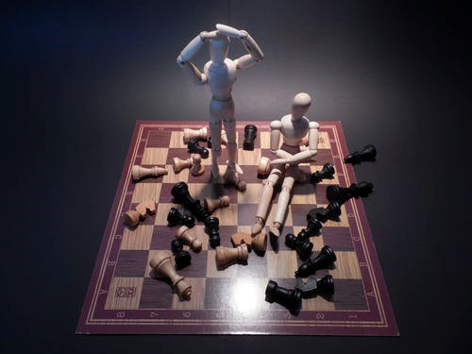
Characteristics of a Successful Mentor
Yoda
Karate Kid
Oprah
Ellen
My boss
My colleague
My Mom

Slide 10
Characteristics of a Successful Mentor

Slide 11
Characteristics of a Successful Mentor
Has an identified area of expertise or experience
Respected by their colleagues
Trustworthy
Can identify strengths and weaknesses in others
Willing to support a mentee
Willing to challenge a mentee

Slide 12
Developing a Formal Mentor/Mentee Relationship
Set ground rules
What will you talk about?
What questions will you (not) answer?
How often will you meet? And where?
How will you provide and receive feedback?
Who is responsible for identifying topics?
What information is strictly confidential?

Slide 13
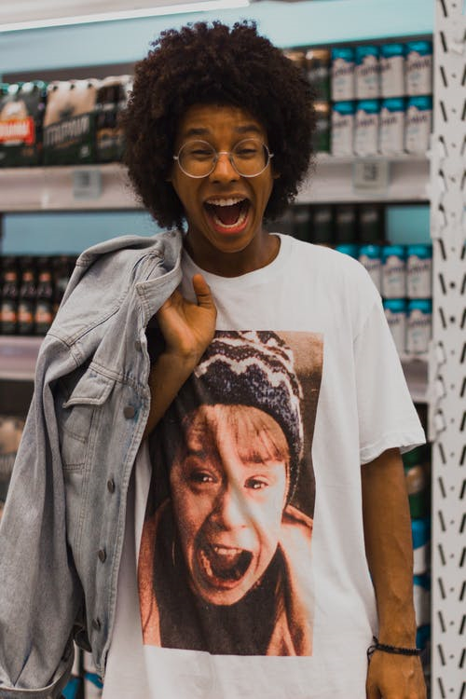
Your First Meeting
Intimidating!
Exciting!
Overwhelming!
Exhausting!

Slide 14
Your First Meeting
Expect your mentee to come to the meeting with little to no preparation
How to find and succeed as a mentor (Tryon, White)
Prepare questions to facilitate conversation
Make it uncomfortable!
(But be supportive!)
Expect the best, but prepare for the “worst”

Slide 15
Your First Meeting
Ice breaker
Identify what strengths you bring to the relationship

Slide 16
Your First Meeting
Come prepared!
What do you want to get out of our mentor/mentee relationship?
What are your career goals?
What are your strengths and weaknesses?
What can I help you accomplish today?
What excites you about your career/job/role?

Slide 17
Providing Feedback to your Mentee
Determine your mutual comfort level with the type of feedback you want to provide
Compliment sandwich
Guidance
Factual
Short and sweet
Sampler platter

Slide 18
Determine Next Steps
How did it go?
What could you have done differently?
What if you disagree on a topic?

Slide 19
Performance Extremes / Expectations
Learn to guide decisions, not make them
This takes practice!
“That’s a good question.
What would you do?”

Slide 20
It Takes a Village
Maybe you’re not the person who is going to be able to hit it home with the tough message.
Be the bigger person and search out someone who can provide this message.

Slide 21
When all else fails….

Slide 22
What if they didn’t ask?

Slide 23
Mentor v Role Model
You are always a role model, whether you want to be or not. We all need good and bad role models in our life. Be the good one. Not the bad one.

Slide 24
Invisible Mentorship

Slide 25
Invisible Mentorship
Suggest new opportunities
Leadership roles
Organizational involvement
Precepting opportunities
Presenting opportunities
NETWORKING
Technicians
Residents
Colleagues
Notes:
RPDs, Managers

Slide 26
Long-Distance Mentorship
It can work, too!
Reset your expectations
Evaluate technology opportunities

Slide 27
Breaking Up
Usually, the communication simply sizzles out
Sometimes a formal break isn’t needed
We all grow up and move on
Sometimes we simply re-evaluate when and how we need mentors or mentees in our life
*Greatest Compliment*
When a mentee surpasses the mentor and the mentor can no longer provide growth opportunities and guidance
Notes:
**GREATEST COMPLIMENT OF A MENTOR IS WHEN THEY CAN NO LONGER TEACH A MENTEE**

Slide 28
Breaking Up
Emotional Bank Account has run dry

Slide 29
Pay It Forward

Slide 31
Assessment Question #1
Match the following roles and definitions:
Coach A. Talks about you
Mentor B. Talks to you
Sponsor C. Talks with you

Slide 32
Assessment Question #1
Match the following roles and definitions:
Coach A. Talks about you
Mentor B. Talks to you
Sponsor C. Talks with you

Slide 33
Assessment Question #2
Which of the following are suggested ground rules for mentor/mentee relationship?
Set a scheduled time and place for recurring meetings.
Set boundaries for what you will and will not discuss related to personal events.
Set boundaries for confidentiality.
Brainstorm discussion topics for future meetings.
All of the above

Slide 34
Assessment Question #2
Which of the following are suggested ground rules for mentor/mentee relationship?
Set a scheduled time and place for recurring meetings.
Set boundaries for what you will and will not discuss related to personal events.
Set boundaries for confidentiality.
Brainstorm discussion topics for future meetings.
All of the above

Slide 35
References
White SJ, Tryon JE. How to find and succeed as a mentor. Am J Health-Syst Pharm. 2007; 64:1258-9.
Tryon JE. Mentors – A gift. In: Letters from Rising Pharmacy Stars: Advice on Creating and Advancing Your Career in a Changing Profession. Cantrell SA, White SJ, ed. American Society of Health-System Pharmacists. 2017.
DeCoske MA, Tryon JE, White SJ, ed. The Pharmacy Leadership Field Guide: Cases and advice for everyday situations. American Society of Health-System Pharmacists. 2011.

Slide 36
Questions?

